Slide 1














IPL Data Analysis
Comprehensive Insights into IPL Performance
Meghana.R
batch:MIP-DA-12

Slide 2



Project Overview
Objective:
Analyze IPL data to gain insights into team and player performance, match outcomes, and key metrics.

Slide 3




Data Sources
Fact Bowling: Bowling statistics by match.
Fact Batting Summary: Batting performance details.
Dim Player: Player profiles including batting and bowling styles.
Dim Match Summary: Summary of match outcomes.

Slide 4

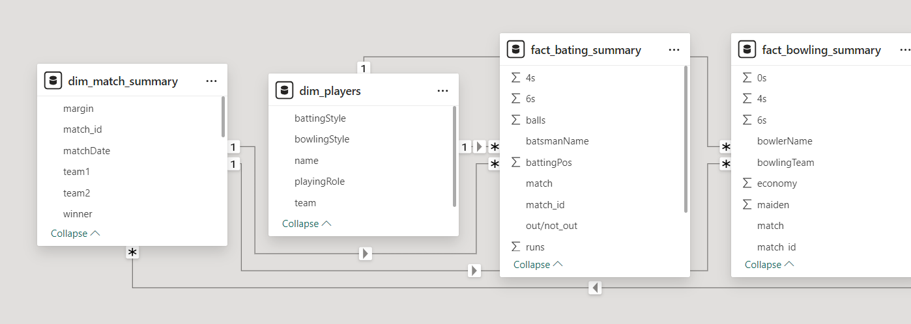
Data Modelling

Slide 5

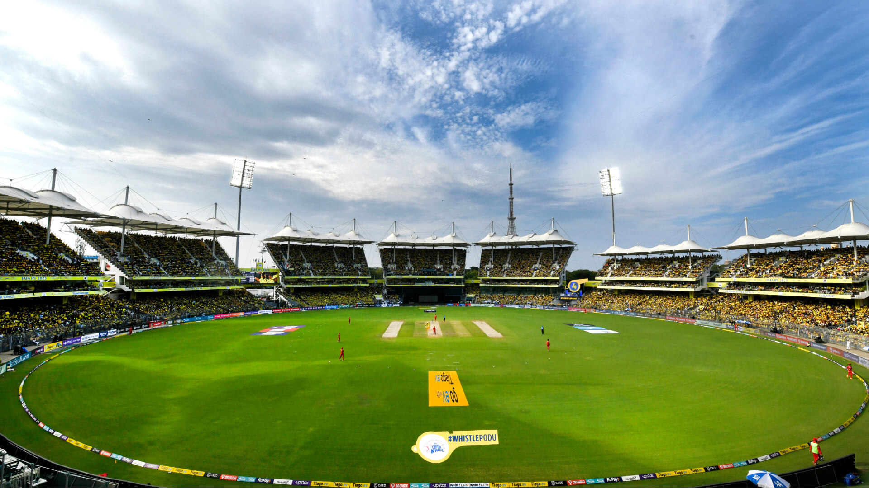



Title Winner Analysis

Slide 6

Orange Cap Analysis

Slide 7


Purple Cap Analysis

Slide 8
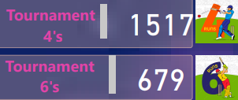
Total 4's and 6's on year

Slide 9
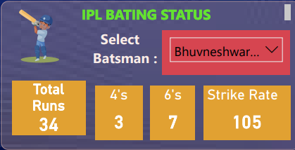
IPL Batting Analysis

Slide 10
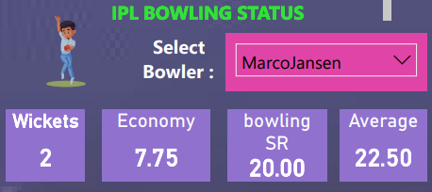
IPL Bowling Analysis

Slide 11

Batting Style of Orange cap
Analysis

Slide 12
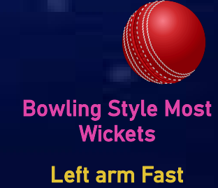
Bowling Style of purple cap Analysis

Slide 13
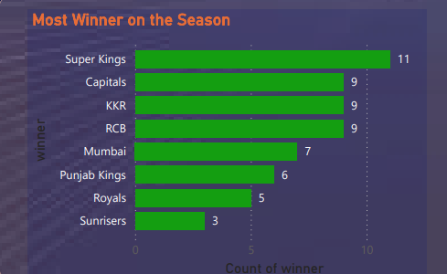
highest winner Analysis

Slide 14
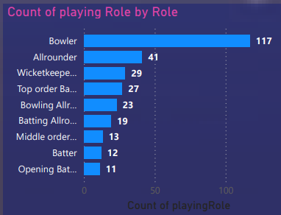
Total players on Role Analysis

Slide 15

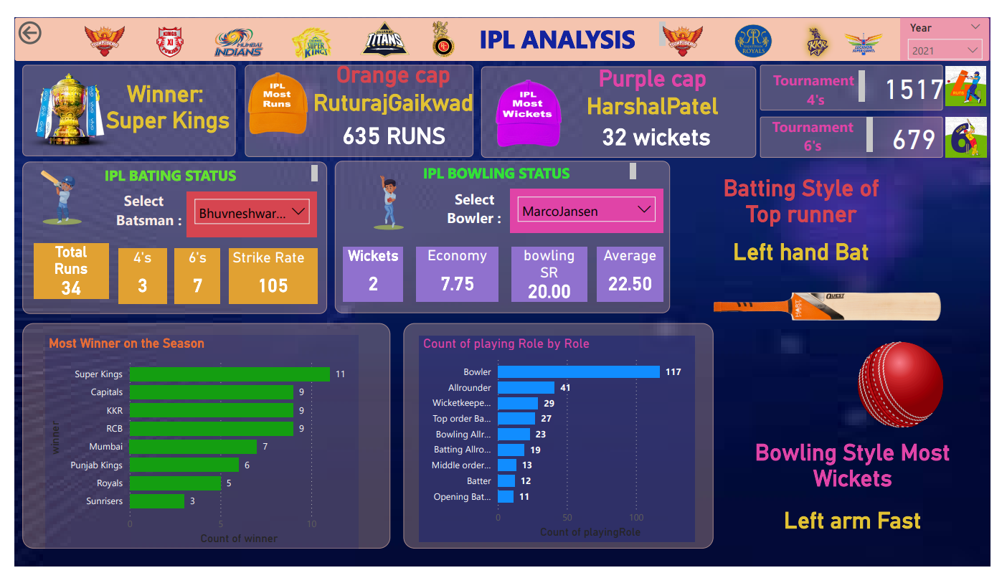
FINAL DASHBOARD

Slide 16

FINAL DASHBOARD

Slide 17

FINAL DASHBOARD

Slide 18
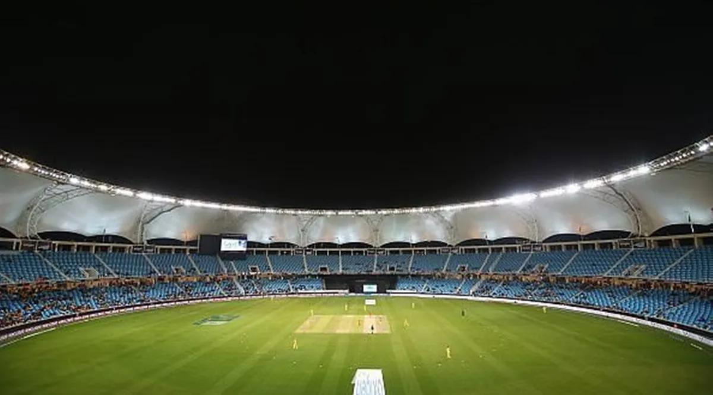
Thank You

